Slide 1

Strangler Fig pattern for incremental modernization of ASP.NET applications
Robert Folkesson
@rfolkes
robert.folkesson@activesolution.se

Slide 2
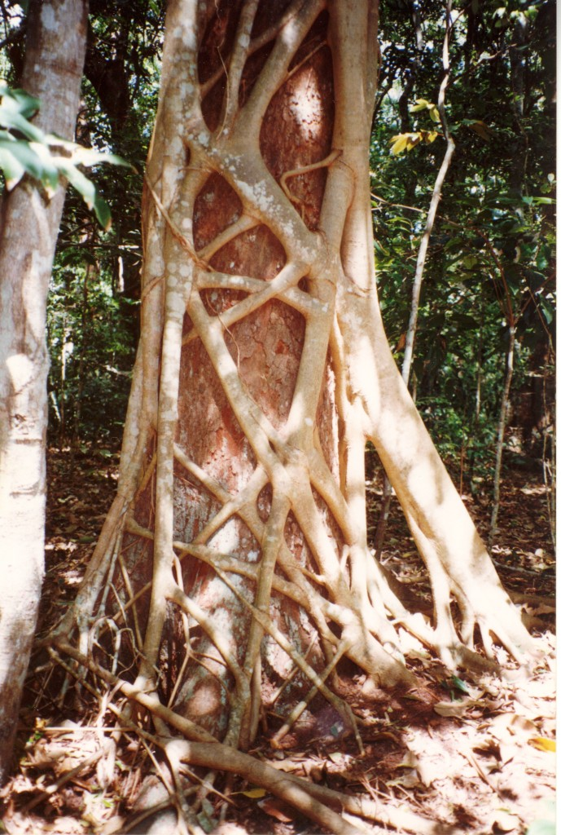
https://martinfowler.com/bliki/ StranglerFigApplication.html

Slide 3
Strangler-fig pattern
Strangler façade
Legacy
Modern
Notes:
Stryparfikus eller strypfikus (även kallad strypfikon) är ingen egen art utan en grupp av fikusväxter som har en likhet i sättet att växa.

Slide 4
Strangler-fig pattern
Strangler façade
Legacy
Modern
Modern
Notes:
Stryparfikus eller strypfikus (även kallad strypfikon) är ingen egen art utan en grupp av fikusväxter som har en likhet i sättet att växa.

Slide 5
Strangler-fig pattern
Strangler façade
Strangler façade
Modern
Legacy
Modern
Legacy
Modern
Notes:
Stryparfikus eller strypfikus (även kallad strypfikon) är ingen egen art utan en grupp av fikusväxter som har en likhet i sättet att växa.

Slide 6
Customer case
Older .NET Framework 4.x MVC-app
New views created gradually with .NET Core and React
New features in older parts of the system was a chance to rewrite
Took about 1 year to migrate all parts
Very successful… but…

Slide 7
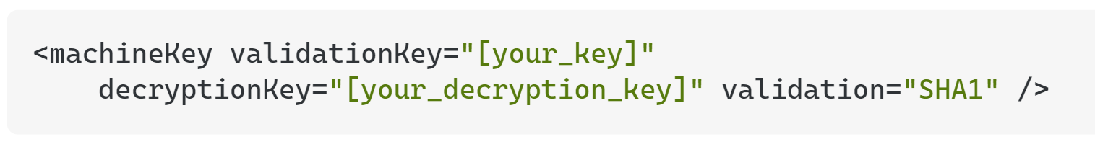
Customer case - challenges
Menu tree dependencies between old became complicated
Session state & cookie handling
Sync old & new code when deploying, feature toggles

Slide 8
YARP – ”yet another reverse proxy”

Slide 9
YARP
Route not found:
Fallback to
legay ASP.NET
Request
Modern ASP.NET Core
Legacy
ASP.NET
YARP
Response
Route is found
In ASP.NET Core

Slide 10

But what about sessions and auth?

Slide 11
System.Web adapters for ASP.NET Core
Microsoft.AspNetCore.SystemWebAdapters Subset of the APIs from System.Web.dll backed by Microsoft.AspNetCore.Http types
Microsoft.AspNetCore.SystemWebAdapters.CoreServices Support for adding services to ASP.NET Core applications to enable migration efforts. This is available for .NET 6+
Microsoft.AspNetCore.SystemWebAdapters.FrameworkServices Support for adding services to ASP.NET Framework applications to enable migration efforts. This is available for .NET 4.7.2+.

Slide 12
Demo: YARP ❤️System.Web adapters

Slide 13
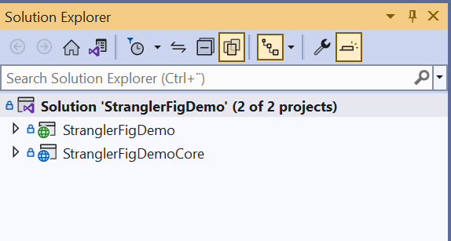
Demo
Legacy ASP.NET
YARP + Web adapters + ASP NET.Core

Slide 14
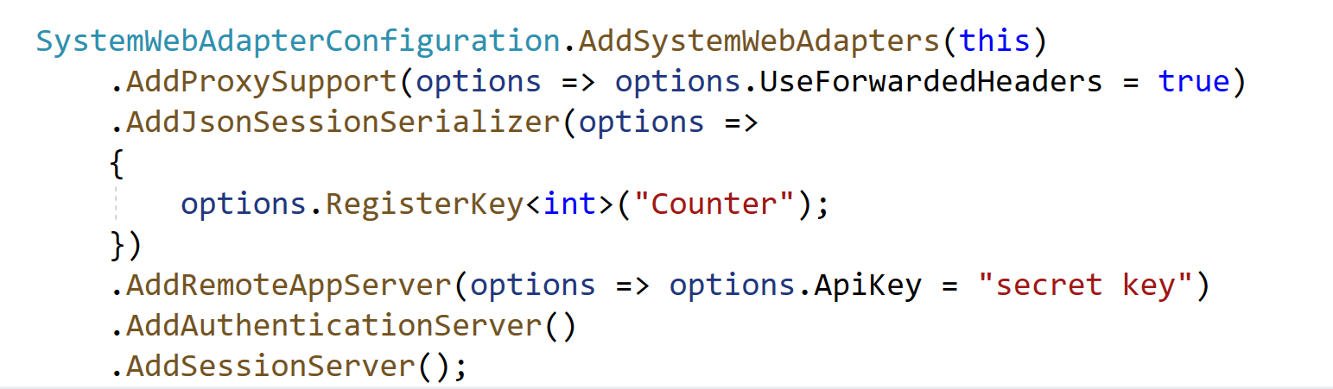
What about authentication?
returns a serialized ClaimsPrincipal
”… returns a serialized ClaimsPrincipal….”
Does not work with Windows Authentication today

Slide 15
Questions?

Slide 16
Thank you!
https://github.com/rfolkes/stranglerfigdemo
@rfolkes
robertf@activesolution.se

